Slide 1
Recent Research Trends in Image Segmentation
Dr. U.Rajyalakshmi, Prof.,
ECE Dept, AEC, Surampalem.

Slide 2
Research
Re -Search
Novelty in the work + Novel Application
Justification

Slide 3
Digital Image Processing
WHY ?
&
HOW ?

Slide 4
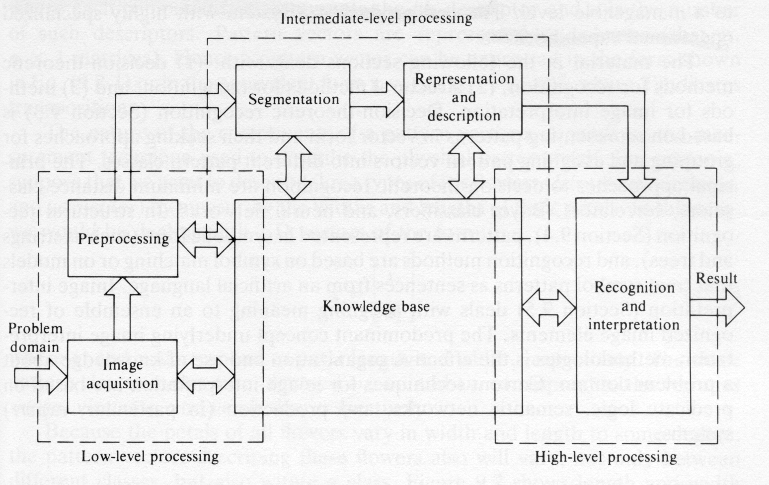
The Three Processing Levels

Slide 5
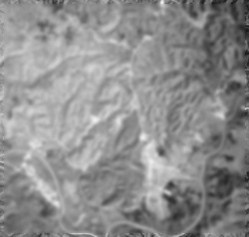
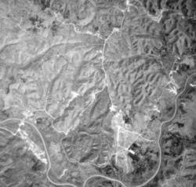
Low-level processing: (Input: Image, Output: Image)
Quality Improvement
Noise removal
Techniques having no intelligent capabilities.
Image Enhancement:
CLAHE
Fig a.Original image Fig b. Enhanced image

Slide 6
Noise in images
Often degraded by random noise
image capture, transmission, processing
Dependent/ independent of image content
To know the type of noise, analyze the histogram of the output image.

Slide 7
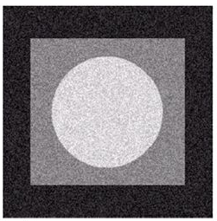
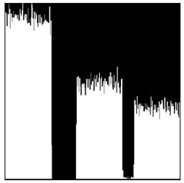
White noise:
constant power spectral distribution.
Fig a. White noisy image Fig b. Histogram

Slide 8
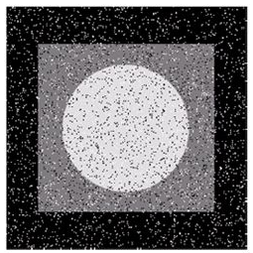

Salt and pepper (Impulse) noise:
Sharp and sudden disturbances in the image signal.
It presents itself as sparsely occurring white and black pixels.
An effective noise reduction method for this type of noise is a median filter. or a morphological filter.
Fig a. Impulse noisy image Fig b. Histogram

Slide 9
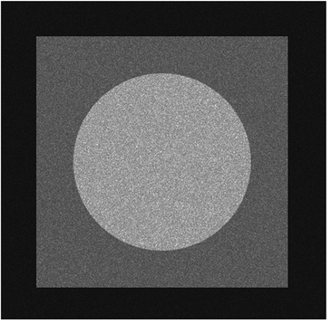
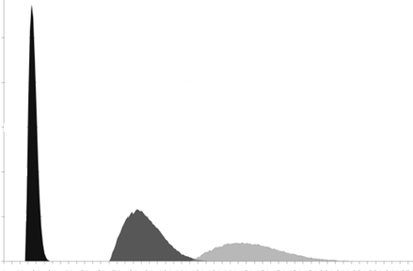
Speckle (Multiplicative) noise:
Lee filter
Kuan filter, transforms multiplicative speckle to linear additive form.
Speckle noise is in direct proportion to the local grey level in any area
Manipulated pixel value, M = C_{P}* K + M_{L} * (1 – K) and
K = (1-((N_{V} *N_{V})/(I_{V}*I_{V})))/(1+(N_{V}*N_{V}))
Where C_{P} : Centre pixel value of speckle window
N_{V} : Noise variation coefficient, =1/sqrt (N_{L}) , N_{L} : Number of looks default value=1.
I_{V} : Image variation coefficient, =sqrt(V_{L})/M_{L} ,M_{L} & V_{L}: Local mean & variance of speckle filter window
Fig a. Speckle noisy image Fig b. Histogram

Slide 10
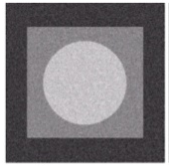
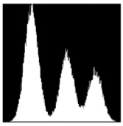
Gaussian noise :
good approximation of practical noise because it represents the worst possible noise.
Gaussian curve = probability density of random variable
µ is the mean
σ is the standard deviation
Gaussian because it has a normal distribution in the time domain with an average time domain value of zero.
Special case is white Gaussian noise.
Conventional spatial filtering techniques for noise removal include: mean (convolution) filtering, median filtering and Gaussian smoothing.
Fig a. Gaussian noisy image Fig b. Histogram
Notes:
White gaussian noise widely constructed in communications and signal processing

Slide 11
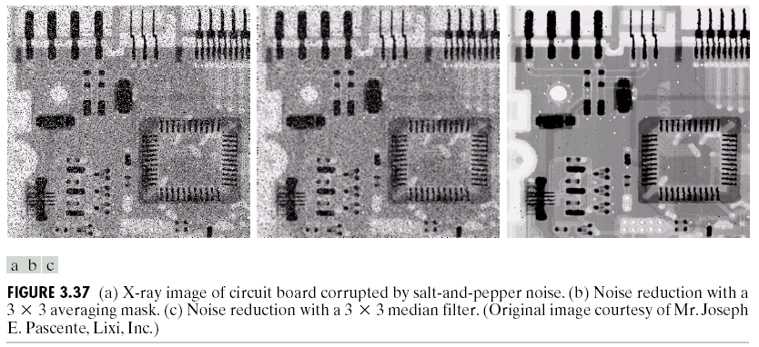
Noise modal formulation in image processing:
additive, noise v and image signal g are independent
multiplicative, noise is a function of signal magnitude
impulse noise (saturated = salt and pepper noise)
Noise Removal

Slide 12
Intermediate-level processing: (Input: Image Output: Attributes)
Extract and characterize the image components.
Some intelligent capabilities are required.
Object recognition /detection, segmentation
Detection and segmentation:
Thresholding
Region-based segmentation
Edge-based segmentation

Slide 13

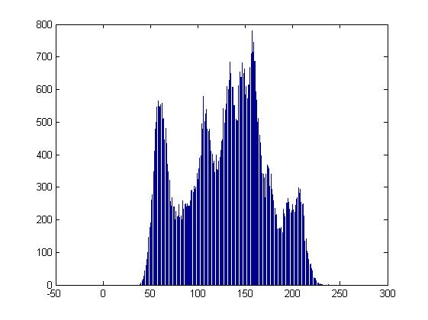
1. Thresholding:
Works on gray scale images and generates binary images.
Finding histogram of gray level intensity.
Fig a. Lena image Fig b. Histogram
Existing Approaches:
Basic Global Thresholding
Variable (Adaptive) Thresholding
Otsu’s Method
Multiple Thresholding

Slide 14
Basic Global Thresholding:
Using a threshold the image is segmented into two black and white regions.
Variable (Adaptive )thresholding:
Segment image use:
Compute the average intensities and .
Compute a new threshold:
Repeated till the difference between values of T is smaller than a predefined parameter.

Slide 15
Otsu’s Method:
First compute the histogram and probabilities of each intensity level.
Choose the threshold to classify in the range of [0,k] and in the range of .
,
Global variance,
Between class variance is
Measure of between class separability
Segmented image
For x = 0,1,2,…,M-1, and y = 0,1,2…,N-1.
Notes:
In OTSU, between class variance is maximized and with-in class variance is minimized.

Slide 16
Multiple Thresholding:
OTSU segments only into two regions.
Multiple Thresholding segments into several distinct regions by using more than two threshold levels.
Drawback: Complexity increases with the threshold level.
Drawback:
Need accurate initial threshold selection.

Slide 17
2. Region-based segmentation:
Region Growing (Split and merge)
Clustering approaches
Seed point can be selected as the mean value, image centroid value, or can be evaluated using thresholding/ histogram techniques
criterion (intensity, texture, location, ...).
Ex: Fan et al. [18] opted seed. Each pixel value is compared with centroid of the respective region and the variance is evaluated. That obtained variance is compared with pre-defined standard variance and pixel possessing less deviation is set to the region; else not considered. The same procedure is repeated for all pixels.
Drawbacks:
Large amount of computation time is required.
Improper selection of seed points effects the segmented areas.
This approach often fail to provide accurate segmentation results due to the intensity inhomogeneities.

Slide 18
Region Segmentation Criteria:
A segmentation is a partition of an image I into
a set of regions S satisfying:
1. ∪ Si = S Partition covers the whole image.
2. Si ∩ Sj = φ, i ≠ j No regions intersect.
3. ∀ Si, P(Si) = true Homogeneity predicate is
satisfied by each region.
4. P(Si ∪ Sj) = false, Union of adjacent regions
i ≠ j, Si adjacent Sj does not satisfy it.

Slide 19
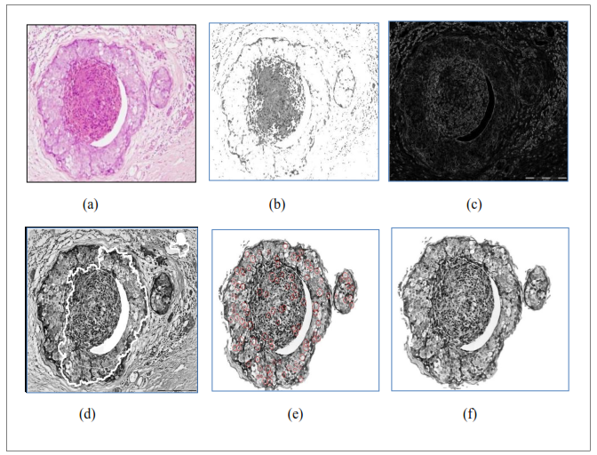
Figure a. Nuclei extraction for H & E stained malignant breast histopathological image (4 X) (a) Malignant breast histology, (b) RGMA segmented result.

Slide 20
Some Clustering Methods: (deals with color images)
K-means Clustering
Isodata Clustering
Histogram-Based Clustering and Recursive Variant
Graph-Theoretic Clustering

Slide 21

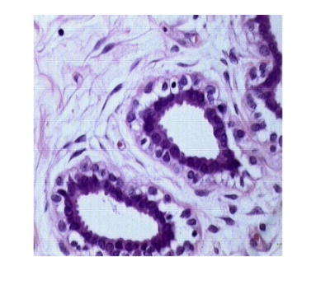
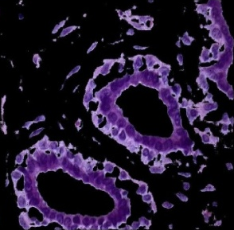
K-means Clustering:
In color images, to reduce lossy compression, instead of directly converting to gray scale the image was first clustered using k-means technique. It divides K (i₁, i₂… i_{K}) observations into N (N≤ K) areas A= {A₁, A₂…A_{N}} by reducing the with-in-class-cluster sum of squares (variance),
N= Where, m_{j} is the mean of all points in A_{j}.
Fig a. Benign histology Fig b. K-means segmented result

Slide 22
Isodata Clustering:
Select several cluster means and form clusters.
Split any cluster whose variance is too large.
Group together clusters that are too small.
Recompute means.
Repeat till 2 and 3 cannot be applied.
We used this to cluster normal vectors in 3D data.

Slide 23
Recursive Histogram-Based Clustering:
color images of real indoor and outdoor scenes
starts with the whole image
selects the R, G, or B histogram with largest peak and finds clusters from that histogram
converts to regions on the image and creates masks for each pushes each mask onto a stack for further clustering

Slide 24
Graph-Partitioning:
An image is represented by a graph whose nodes are pixels or small groups of pixels.
The goal is to partition the vertices into disjoint sets so that the similarity within each set is high and across different sets is low.
In Minimal cuts, edge (u,v) has a weight w(u,v) that represents the similarity between u and v.
Graph G can be broken into 2 disjoint graphs with node sets A and B by removing edges that connect these sets.
Let cut(A,B) = ∑ w(u,v). One way to segment G is to find the minimal cut.

Slide 25
Normalized Cut
Minimal cut favors cutting off small node groups, so Shi proposed the normalized cut.
cut(A, B) cut(A,B)
Ncut(A,B) = ------------- + -------------
asso(A,V) asso(B,V)
normalized
cut
asso(A,V) = ∑ w(u,t)
u∈A, t∈V
How much is A connected
to the graph as a whole.

Slide 26
3. Edge-based segmentation:
Using mask to detect edge in image by convolution.
Basic Edge Detection
Hough transform
Watersheds
Active contours
Level sets
Multiphase Level sets

Slide 27
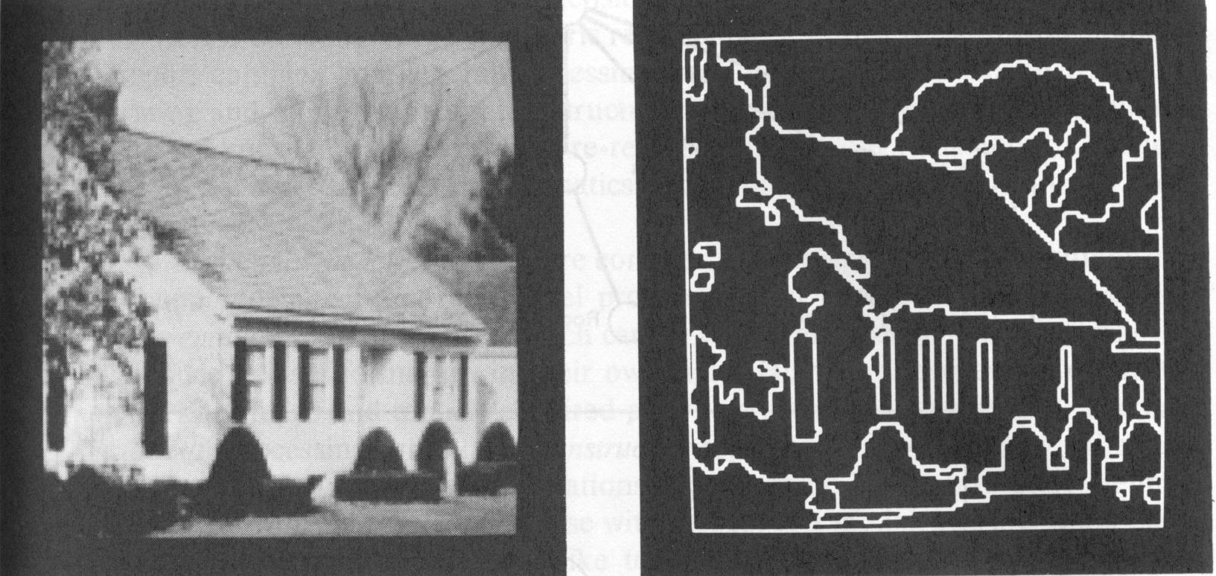
Fig a. Input image Fig b. Basic edge detected result

Slide 28

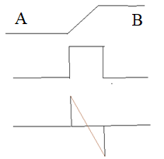
Basic edge detection:
Image
intensity
first-order deviation
second-order deviation

Slide 29
Gradient:
The image gradient is to find edge strength and direction at location (x,y) of image.
The magnitude (length) of vector , denoted as M(x,y):
The direction of the gradient vector is given by the angle:

Slide 30
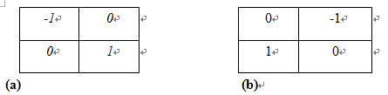
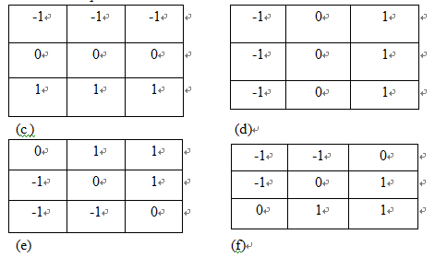
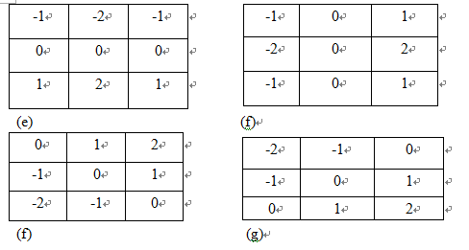
Roberts cross-gradient operators:
Prewitt operator:
Sobel operator:

Slide 31
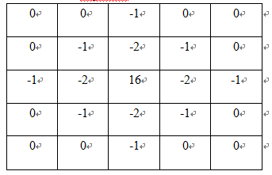
The Marr-Hildreth edge detector(LoG):
This is second-order deviation, we call Laplacian.
Filter the input image with an n*n Gaussian low pass filter. 99.7% of the volume under a 2-D Gaussian surface lies between about the mean. So .
Notes:
For linear processing

Slide 32
Hough Transform:
Find edge links and straight lines
require continuous path of edge pixels
HT doesn’t require connected / nearby points
Also used to detect the location of circles

Slide 33
HT - parametric representation:
consider, single point (x,y), the image space co-ordinates
infinite number of lines pass through (x,y)
each line = solution to equation
simplest equation:
y = kx + q
k – gradient, q - y intercept
Straight line is characterized by k & q, using (k,q) - parameter space

Slide 34
circle Hough Transform (CHT):
Find the local maxima points
For each point with centre (p_{o},q_{o}) generate a circle with pre-defined radius S can be represented with the equations p= p_{o} + S cos (θ), q= q_{o} + S sin (θ). CH transform can be stated as
Where ‘∂’ be the Kronecker delta, also CHT_{dispace} behaves like an accumulator, which adds the similar intensity levels of g_{I}(p, q) to the circle located at (p_{o},q_{o}).
Drawback:
Much of the efficiency of the Hough transform is dependent on the quality of the input data: the edges must be detected well for the Hough transform to be efficient.
Overlapping edges cannot be found using CHT.

Slide 35
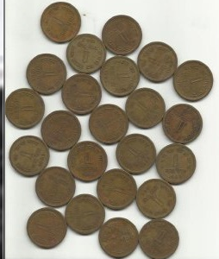
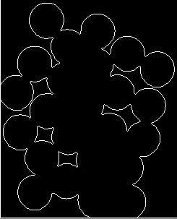
Fig a. Input image Fig b. Detection of circles using CHT

Slide 36
2. Watershed transform:
Unsupervised morphology type of gray-scale segmentation.
The image pels are divided as local minima, catchment basins (low gradient values) and watershed lines (maximum gradient value which separate neighboring basins)
The flooding process relies on image gradients having various local minima, it suffer from over-segmentation.
To overcome this, internal (associated with objects of interest) and external (associated with background) markers (Marker Controlled Watershed Approach (MCWA)) are introduced.
For small and fixed Structuring Element (SE) size, during opening and closing morphology some details may be lost.

Slide 37
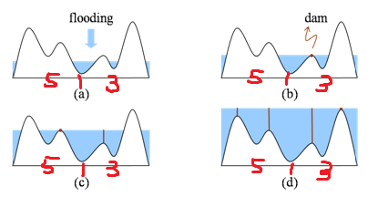
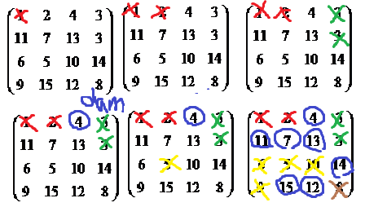
Watersheds
Algorithm:
, g(s,t) is intensity.
n= min+1 to n = max +1. And let T[n]=0, others 1.
, is minimum point beneath n.

Slide 38
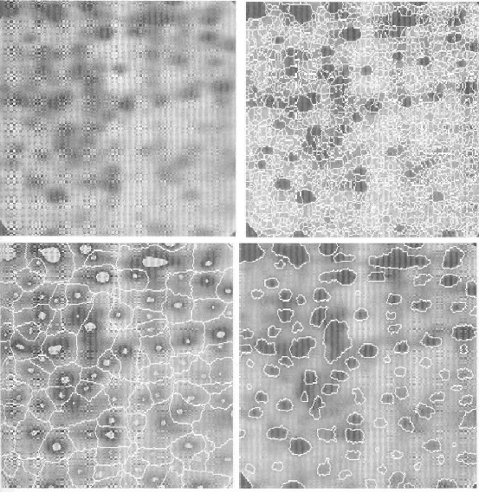
Markers
External markers:
Points along the watershed
line along highest points.
Internal markers:
(1) That is surrounded higher points .
(2) Points in region form a connected component
(3) All points in connected component have the same
intensity.

Slide 39
In marker controlled watershed, for small structuring Element (SE), Opening (erosion followed by dilation) and closing (dilation followed by erosion) morphology will eradicate the bright and dark areas.
So, an adaptive SE size is built using gradient image by weighted variance concept discussed below.
Weighted variance V_{W} (p, q) is obtained as:
V_{W}(p,q)=W₁(g_{I}(p-1,q-1)- g_{I} (p,q))² + W₂(g_{I}(p-1,q)-g_{I} (p,q))² +W₃(g_{I}(p-1,q+1)- g_{I} (p,q))² +
W₄(g_{I}(p,q-1)- g_{I} (p,q))²+ W₅ (g_{I}(p,q+1) - g_{I} (p,q))² + W₆(g_{I}(p+1,q-1)- g_{I} (p,q))²+
W₇(g_{I}(p+1, q) - g_{I} (p,q))² + W₈(g_{I}(p+1,q+1)- g_{I} (p,q))²
Where W_{h =} 1/r_{h}, represents the weighting coefficient, r_{h} defines the distance between the point (p, q) to the neighbourhood (p_{h}, q_{h})
and is equal to, r _{h}=
and estimated gradient, g_{I}(p,q) defined as = D_{s}(I) - E_{s}(I)

Slide 40
D_{s}(I) and E_{s}(I) are the gray scale dilation (operator: ⊕) & erosion (operator: Θ) of a Structuring Element s respectively.
Therefore, SE map is obtained as,
M_{s} (p, q) = │- log (ά X V_{W} (p, q)) │,
Where, ά is initially defined value for M_{s} (p, q), and │.│ is for rounding. Range of M_{s} (p, q) is (0, R_{max}); R_{max} is the SE maximum size.
With M_{s} (p, q), all pixels in the original image are altered to get modified image as
M_{I} (p, q) = [g_{I}(p, q) ͦ M_{s} (p, q)] • M_{s} (p, q)
• and ͦ define the closing and opening manipulations respectively. Now this modified input is fed to the MCWA for nuclei segmentation to obtain M_{o} (p, q) .

Slide 41
3. Level sets:
Level Sets(LS) comes under geometric model of active contours.
Instead of curve, LS define the surface ϕ, where the zero LS ϕ(p,q,t=0) is same as the contour S(k).
Minimizing or expanding the curve effects the same to LS surface, so handles any type of concavities, splitting/ merging.
Drawbacks:
Initialization should be nearer to boundaries.
It segments the given image only into two different regions.
More computational time.
But, traditional LS cannot generate accurate output for H & E stained BC images possessing local intensity
inhomogeneities .

Slide 42
4.Multi-Resolution Analysis:
Wavelets efficiently localize frequency information in spatial (temporal) domain. Discrete Wavelet Transform: splits into ¼ th size smooth, horizontal, vertical and diagonal resolutions. But DWT being 1-D it is limited to smoothness of curves.
Curvelets: 2-D provides curve smoothness, and provides multiscale decomposition and directional decomposition
Drawback :1.Need more computational time.
2.Curvelet construction is simple in continuous domain and complex in discrete domain.
Contourlets – Similar to curvelets, it is 2D transform(smoothness of curves can be considered ) but it is shift variant (due to usage of up samplings and down samplings in filter bank construction)
Non Sub-sampled Contourlet (NSC) Transform.

Slide 43
Advantages of K-means+ ASEMCWA+ NMPLS:
No necessity of re-initialization.
Fixed parameter values makes the proposed NMPLS model not sensitive to parameter selection.
By adjusting the image regularization H^{F}(ϕ) and δ(ϕ) parameters, false and weak boundaries can be handled.
Incorporated new speed term h(p,q) in noise minimization functional to stop CE near the edges.
The estimated bias-field is used to correct the local intensity inhomogeneities that improves the segmentation efficiency.
Less computational time and few iterations.
Limitations of K-means+ ASEMCWA+ NMPLS:
Need improvement of contour smoothness.
Spurious gradients.
Notes:
any fluctuation because of noise in the tissue image grey-levels develops spurious gradients that lead to severe-segmentation which degrade the ASEMCWA output.

Slide 44
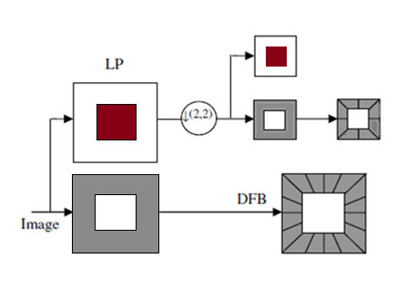
Figure: Block diagram of the contourlet transform. The image is first decomposed into sub bands through 2-level Laplacian Pyramid (LP) iteratively and then each band pass/ detail image is analyzed by the Directional Filter Banks. (DFB)
Construction of the Contourlet Transform :
Two steps:
Sub-bands decomposition (by Laplacian Pyramid) and
directional edge information ( by Directional Filter Bank).
Drawback: Presence of down samplers and up samplers in LP and DFB, this is shift variant.

Slide 45
Contrast with contourlet, NSC transform possesses
1. Non-subsampled LP obtained by non subsampled 2-channel 2-D filter banks
2. Non-subsampled DFB obtained by switching off down/up samplers in 2-channel DFB structure while filter upsampling accordingly.
NSC is totally shift invariant, multi directional and Multi scale extension having quick execution.

Slide 46
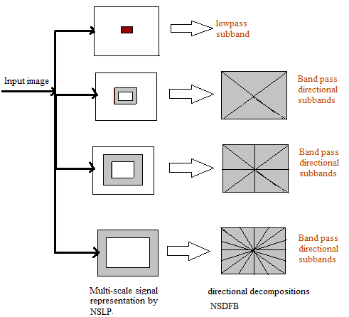
Figure: Three-level NSC transform sub-band and directional decomposition.

Slide 47
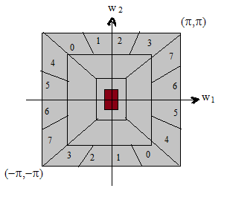
Non-subsampled LP preserves multiscale feature and non-subsampled DFB possess directionality.
NSDFB efficient implementation via a ‘n’ level tree-structured decomposition that leads to 2^{n} sub-bands
(for n=3, ) with wedge-shaped frequency partitions.
Figure: NSDFB frequency partitioning

Slide 48
Paper | Limitations
Zheng et.al. [16] | Edge based approaches are good for high contrast images but severely noise sensitive.
Fan et.al. [18] | Need best initial selection point, limited to local view, and need more computational time.
Wang et.al. Vincent and Soille, [17,19] | Over-segmentation problem, lose details during morphological variations.
Chan and Vese [7,8] | Gradient data is utilized as stopping criteria for level sets. For critical local inhomogeneities, gradient data cannot put a halt for CE even at real edges leading to leakages.
Zhang et.al [20] | Re-initialization is necessary, smoothness cannot be accurately achieved.
Chunming Li et. al [10] | Cannot be able to segment H&E stained BC tissue images that possess critical inhomogeneities, weak and blurred edges. Computationally complex.

Slide 49



Subjective performance measures evaluation:
Sensitivity or True Positive Rate(a measure that recognizes all foreground pixels correctly) defined as:
Specificity or True Negative Rate (a measure that recognizes all background pixels correctly) defined as:
Accuracy (which measures number of correctly identified pixels out of total pixels appeared) . It provides the approach overall performance.
Precision or Positive-Predicted Value (PPV) must be higher to get positives only from true positives, else not from false positives.

Slide 50

True Positive: Correctly identified foreground pixels from the segmented area
True Negative: Correctly identified background pixels
False Positive: In correctly identified foreground pixels
False Negative: In correctly identified background pixels
Dice similarity index (> 0.7)
Computational Time: Difference between the return time of the algorithm at start up of the process (tr, start) and the return time at the end of the process (tr, end).
t_{c} = t_{r, start} - t_{r, end}
.

Slide 51
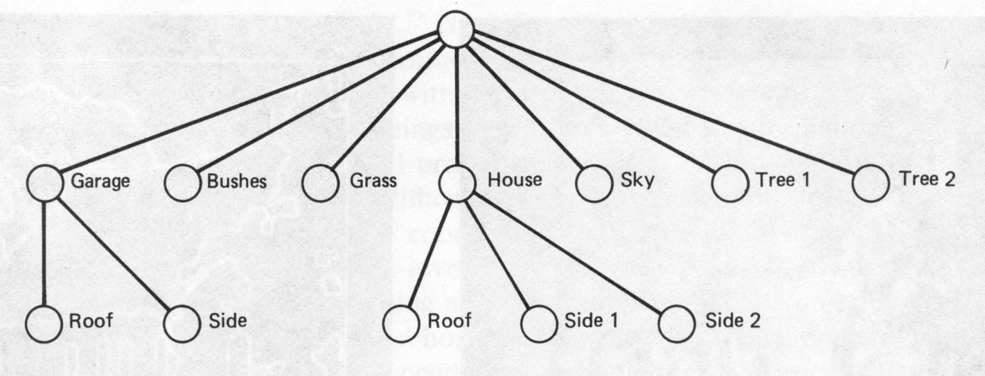
High-level processing: (Input:Attributes,Output:Understanding)
Recognition and interpretation.
Procedures require high intelligent capabilities
Examples: Scene understanding, autonomous navigation

Slide 52
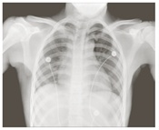
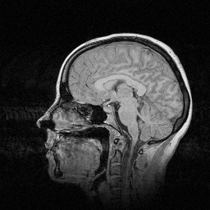
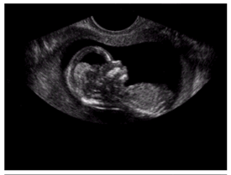
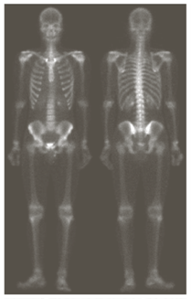
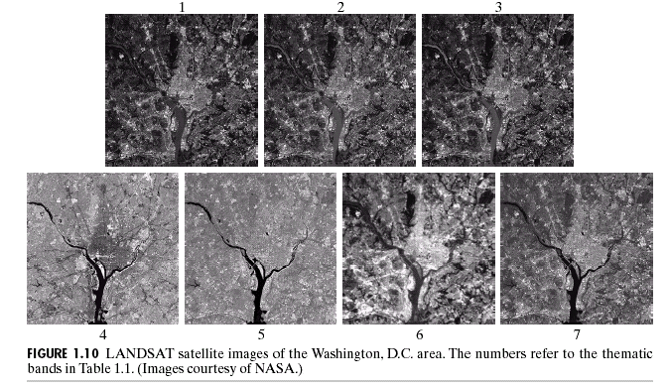
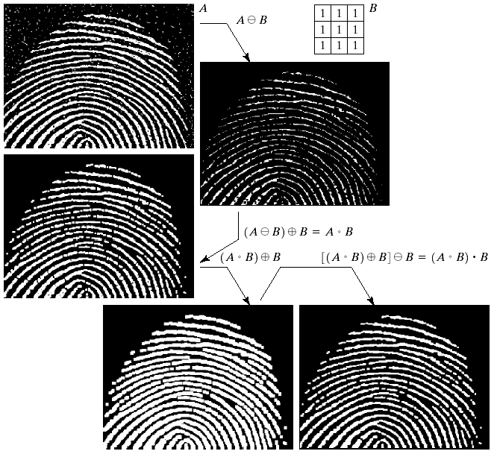
Applications : Medicine
X-ray imaging
Magnetic Resonance Imaging
Ultrasound
Geographic Information Systems:
Satellite imagery and Terrain classification (LANDSAT)
Fingerprint recognition
Gamma-ray imaging

Slide 53
Security
Enhancement of CCTV images
Number plate recognition for speed cameras/automated toll systems
Fingerprint recognition

Slide 54
Image Segmentation applications:
Heart functionality assessment in cardiac images,
Medical Imaging applications (tumor delineation) ,
Object recognition and detection (face detection),
Motion Tracking,
Object-based measurements such as size and shape,
Fingerprint recognition,
Classification of terrains visible in satellite images,
Detection of bone, tissue, etc., in medical images,
Mass detection in mammograms (Macroscopic diagnostics),
Nuclei detection in microscopic images (biopsy images) etc...

Slide 55
Thank you one and all

